Slide 1

Intelligent Design of Scientific Software
Robert van de Geijn
Institute for Computational Engineering and Science
Department of Computer Science

Slide 2
Show Me the Performance…
This talk will be mostly devoid of performance graphs.
We kind of take performance for granted…

Slide 3
Motivation
Throughout we will use Cholesky factorization as a motivating example:
Given Symmetric Positive Definite A compute L such that
A = L L^{T}
L typically overwrites A.

Slide 4
Blocked Right-looking Algorithm

Slide 9
Done
Done

Slide 10
The State-of-the-Art in 1980
LINPACK:
dchdc(a,lda,p,work,jpvt,job,info)
MATLAB:
L = chol( A )
J. J. Dongarra, C. B. Moler, J. R. Bunch, and G. W. Stewart. LINPACK Users' Guide, 1979.
Cleve Moler. MATLAB-an interactive matrix laboratory. 1980.

Slide 11
The State-of-the-Art in 1990
LAPACK:
dpotrf( UPLO, N, A, LDA, INFO )
Anderson et al. LAPACK: A portable linear algebra library for high-performance computers. Supercomputing 1990.

Slide 12
DLA State-of-the-Art in 1996
ScaLAPACK
PBLAS
LAPACK
Basic Linear
Algebra Communication
Subprograms
BLAS
Blackford et al. ScaLAPACK Users’ Guide. SIAM Press. 1997.

Slide 13
ScaLAPACK Cholesky Factorization
DO 20 J = JN+1, JA+N-1, DESCA( NB_ )
JB = MIN( N-J+JA, DESCA( NB_ ) )
I = IA + J – JA
CALL PDPOTF2( UPLO, JB, A, I, J, DESCA, INFO )
IF( INFO.NE.0 ) THEN
INFO = INFO + J - JA
GO TO 30
END IF
*
IF( J-JA+JB+1.LE.N ) THEN
CALL PDTRSM( 'Right', UPLO, 'Transpose', 'Non-Unit', N-J-JB+JA,
$ JB, ONE, A, I, J, DESCA, A, I+JB, J, DESCA )
CALL PDSYRK( UPLO, 'No Transpose', N-J-JB+JA, JB, -ONE,
$ A, I+JB, J, DESCA, ONE, A, I+JB, J+JB,
$ DESCA )
*
END IF
20 CONTINUE

Slide 14
Parallel Linear Algebra Package (PLAPACK)
Conceived in Spring 1996.
CS395T Parallel Computing at UT Austin
Users’ manual for fictitious distributed memory parallel dense linear algebra (DLA) package (SL – Simple Library)
Class implemented parts of the package
Using PLAPACK, MIT Press, 1997
RvdG with contributions from Carter Edwards, John Gunnels, Greg Morrow, James Overfelt, …
First release of PLAPACK: Spring 1997
Funding
Subcontract from PRISM project (itself funded by NSF)
The Intel Research Council

Slide 15
PLAPACK Cholesky Factorization
PLA_Obj_view_all( A, &ABR );
while ( TRUE ) {
PLA_Obj_split_size( ABR, PLA_SIDE_TOP, &size_top, &owner_top );
PLA_Obj_split_size( ABR, PLA_SIDE_LEFT, &size_left, &owner_left )
if ( 0 == ( size = min( min( size_top, size_left), nb_alg ) ) ) break;
PLA_Obj_split_4( ABR, size, size, &A11, PLA_DUMMY,
&A21, &ABR );
PLA_Local_chol( PLA_LOWER_TRIANGULAR, A11 );
PLA_Trsm( PLA_SIDE_RIGHT, PLA_LOWER_TRIANGULAR,
PLA_TRANSPOSE, PLA_NONUNIT_DIAG, one, A11, A21 );
PLA_Syrk( PLA_LOWER_TRIANGULAR,
minus_one, A21,
one, ABR );
}
Code devoid of indexing.

Slide 16
CALL PDTRSM( 'Left', UPLO, 'Transpose', 'Non-Unit’, JB, N-J-JB+JA,
& ONE, A, I, J, DESCA, A, I, J+JB, DESCA )
CALL PDTRSM( 'Left', UPLO, 'Transpose', 'Non-Unit’, JB, N-J-JB+JA,
& ONE, A, I, J, DESCA, A, I, J+JB, DESCA )
PLA_Trsm( PLA_SIDE_RIGHT, PLA_LOWER_TRIANGULAR,
PLA_TRANSPOSE, PLA_NONUNIT_DIAG, one, A11, A21 );
PLA_Trsm( PLA_SIDE_RIGHT, PLA_LOWER_TRIANGULAR,
PLA_TRANSPOSE, PLA_NONUNIT_DIAG, one, A11, A21 );

Slide 17
PLAPACK Innovations
Object-based programming inspired by MPI.
Index-free programming.
Physically Based Matrix Distribution.
C. Edwards, P. Geng, A. Patra, and R. van de Geijn, "Parallel Matrix Decompositions: have we been doing it all wrong?" PLAPACK Working Note #1, TR-95-39, Department of Computer Sciences, University of Texas, Oct. 1995
Distribution of matrices induced by distribution of vectors.
Describe distribution of data and let library figure out what communication is required.
Many new parallel DLA algorithms.
Families of algorithms.
Sensible user interface.
M. Sidani and B. Harrod. Parallel Matrix Distributions: Have we been doing it all right? LAPACK Working Note 116, 1996.

Slide 18
Two Decades of Research and Development
FLAME
Notation
Methodology
APIs
FLAMEC
FLAME@lab
FLAMEPy
FLaTeX
libflame
FLAME-it
SuperMatrix
FLAPACK
Elemental
BLIS
LAC/LAP
DxT
LAFF

Slide 19

PLAPACK’s Legacy: 1996 - 2016
FLAME
Notation
Methodology
APIs
FLAMEC
FLAME@lab
FLAMEPy
FLaTeX
libflame
FLAME-it
SuperMatrix
FLAPACK
Elemental
BLIS
LAC/LAP
DxT
LAFF

Slide 20
What lessons can we learn?

Slide 21
Overview
Notation
Methodology
APIs
libflame
Full LAPACK functionality
BLIS
Elemental
DxT/DxTer
Lessons/Conclusion

Slide 22
Overview
Notation
Methodology
APIs
libflame
Full LAPACK functionality
BLIS
Elemental
DxT/DxTer
Lessons/Conclusion

Slide 45
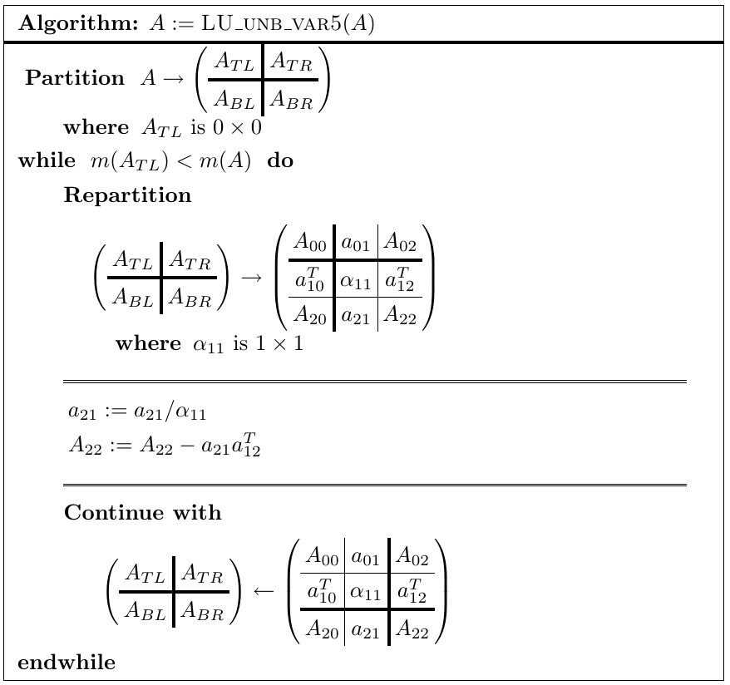

Slide 46
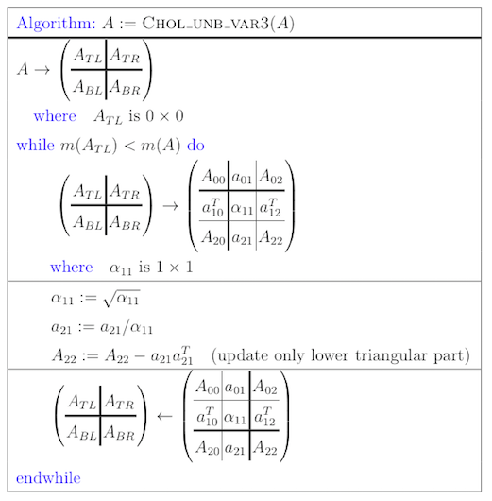

Slide 64
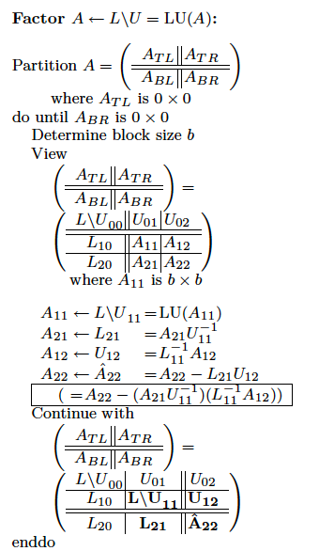
Related Publications
Xiaobai Sun, Enrique S. Quintana, Gregorio Quintana, and Robert van de Geijn. A Note on Parallel Matrix Inversion. SIAM Journal on Scientific Computing , Vol. 22, No. 5, pp. 1762--1771. (2001)
Most of our publications since 2000

Slide 65
Summary
Express algorithms at the level of abstraction at which one reasons.
Teach abstraction early
Linear Algebra: Foundations to Frontiers (LAFF)
Maggie Myers and RvdG
Introductory linear algebra course
Massive Open Online Course offered by edX.
900 page “Notes to LAFF With” (PDF) available from ulaff.net
LAFF– Notes on Numerical Linear Algebra
Graduate numerical linear algebra course.
Available from ulaff.net

Slide 66
Overview
Notation
Methodology
APIs
libflame
Full LAPACK functionality
Elemental
BLIS
DxT/DxTer
Lessons/Conclusion

Slide 67
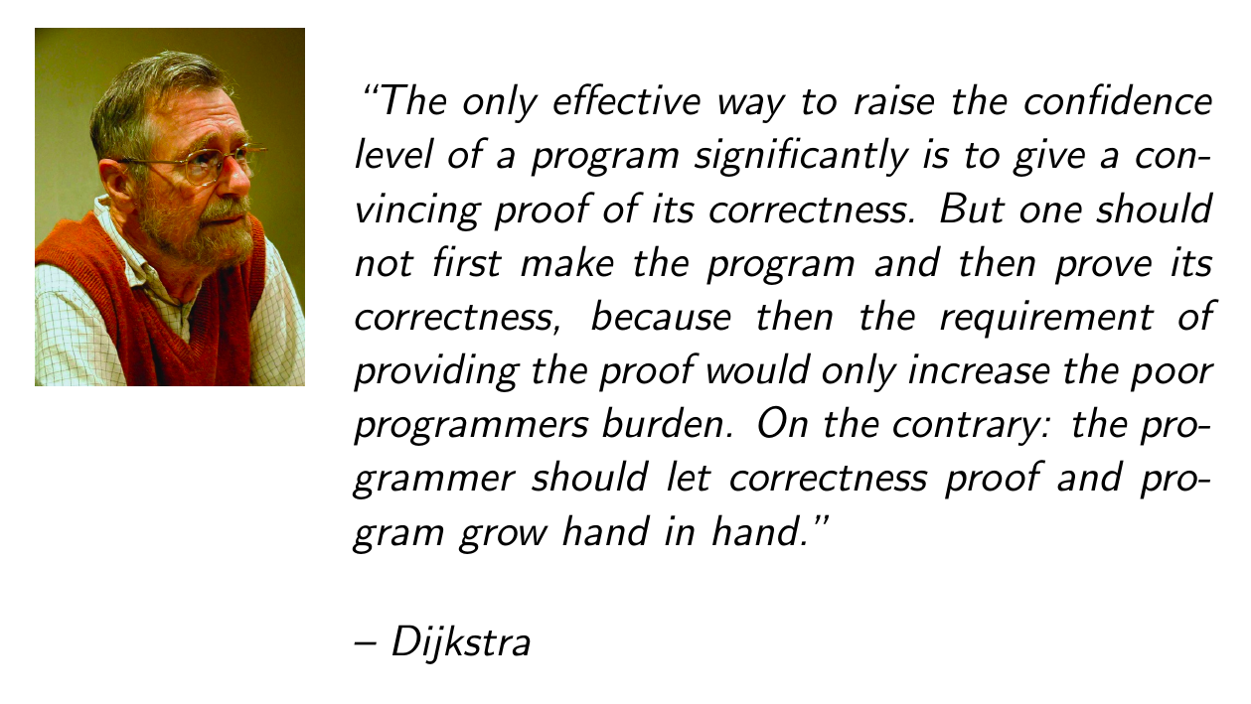

Slide 70


Slide 71
Loop invariant
A loop invariant is a predicate that is true before and after each iteration of the loop.
done
done
done
partially
updated

Slide 72
Loop invariant
A loop invariant is a predicate that is true before and after each iteration of the loop.
L_{TL}
*
L_{BL}
A_{BR -} L_{BL}L_{BL}^{T}
Important: We can determine the loop invariant a priori

Slide 73
The Weapon of
Math Induction
for the War on Error

Slide 86
How Systematic is the Methodology?
But what about more complex matrix computations?
They may involve many matrices.
Can the method be automated?
Diego Fabregat-Traver and Paolo Bientinesi.
Cl1ck

Slide 88
Related Publications
John A. Gunnels. A Systematic Approach to the Design and Analysis of Linear Algebra Algorithms. Ph.D. Dissertation. Nov. 2001
John Gunnels, Fred G. Gustavson, Greg M. Henry, Robert A. van de Geijn. FLAME: Formal Linear Algebra Methods Environment, ACM Transactions on Mathematical Software (TOMS), 2001
Paolo Bientinesi, John A. Gunnels, Margaret E. Myers, Enrique S. Quintana-Orti, Robert A. van de Geijn. The science of deriving dense linear algebra algorithms. ACM Transactions on Mathematical Software (TOMS), 2005
Paolo Bientinesi. Mechanical Derivation and Systematic Analysis of Correct Linear Algebra Algorithms. Ph.D. Dissertation. Aug. 2006
Robert A. van de Geijn and Enrique S. Quintana-Orti. The Science of Programming Matrix Computations. www.lulu.com , 2008
Paolo Bientinesi, John Gunnels, Maggie Myers, Enrique Quintana-Orti, Tyler Rhodes, Robert van de Geijn, and Field Van Zee. Deriving Linear Algebra Libraries. Formal Aspects of Computing. 2012
Tze Meng Low. A Calculus of Loop Invariants for Dense Linear Algebra Optimization. Computer Science. December 2013.
…

Slide 89
Summary
Notation facilitates formal derivation of algorithms.
Yes, it is systematic to the point where it has been automated.
Embrace goal-oriented programming!
Watch video
“Weapons of Math Induction for the War on Error” VIDEO SLIDES
Read
RvdG and Quintana.
The Science of Programming Matrix Computations.
lulu.com, 2008.
Take LAFF – Programming for Correctness
Maggie Myers and RvdG
New MOOC to be offered in Spring 2017.

Slide 90
Overview
Notation
Methodology
APIs
libflame
Full LAPACK functionality
Elemental
BLIS
DxT/DxTer
Lessons/Conclusion

Slide 91
Representing Algorithms in Code
How do we translate correct algorithms to correct code?

Slide 92
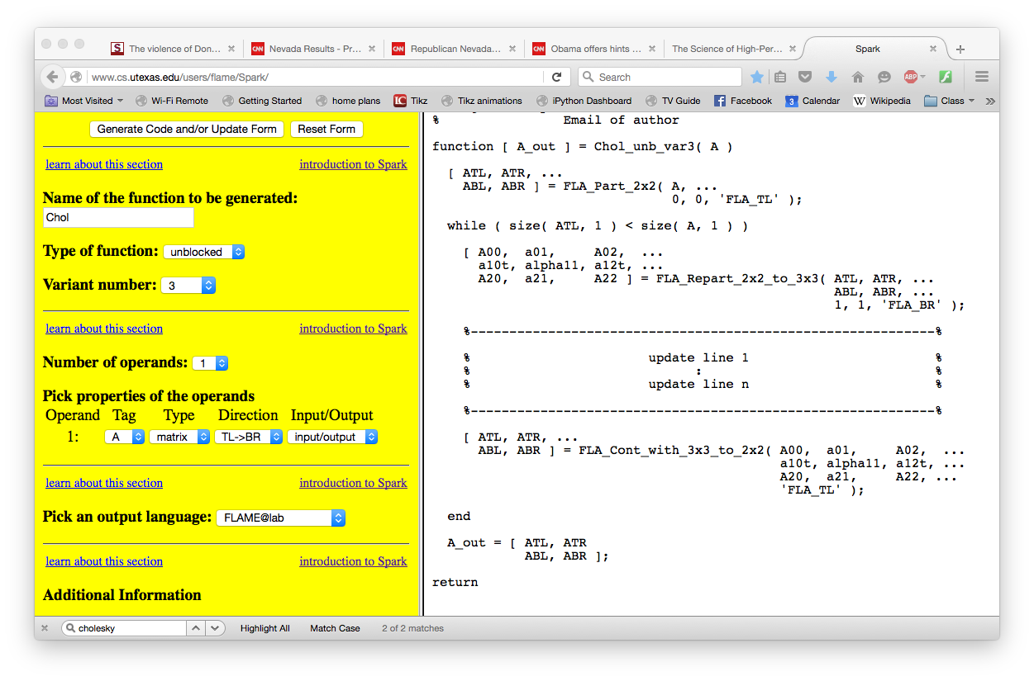

Slide 94
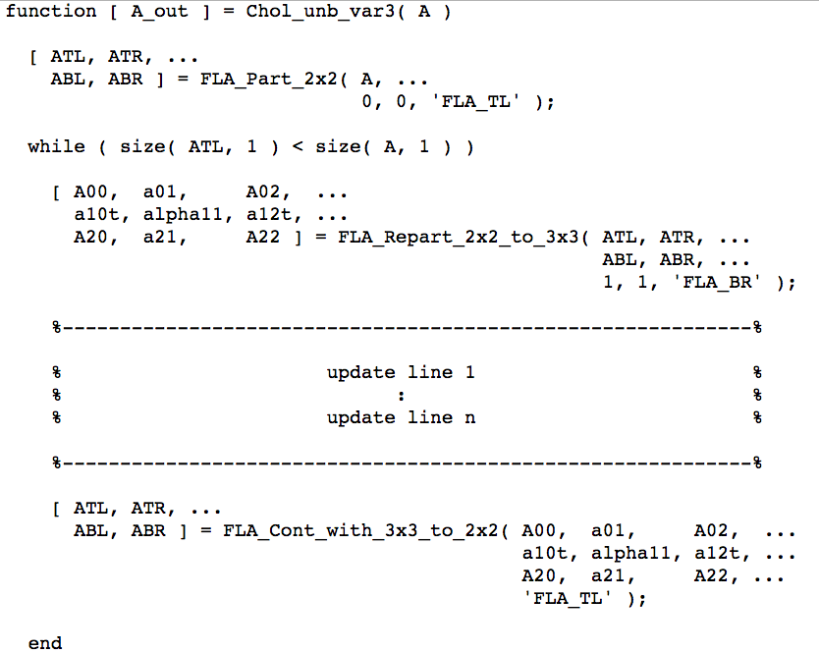

Slide 96
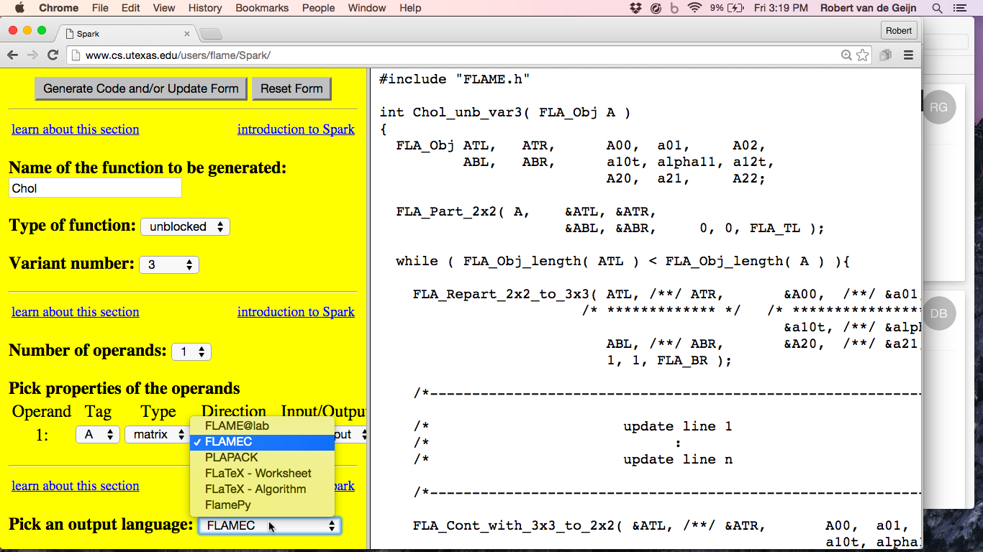

Slide 97
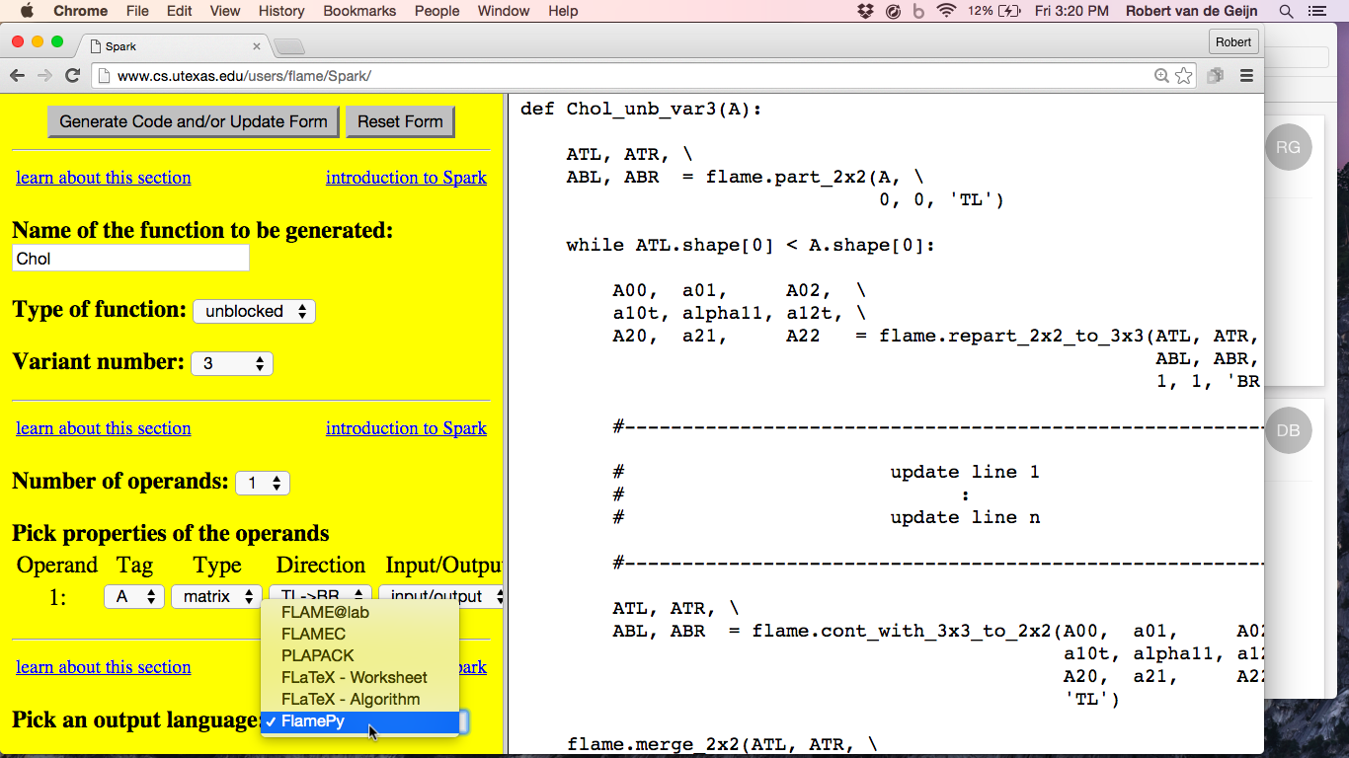

Slide 98
Related Publications
John Gunnels, Fred G. Gustavson, Greg M. Henry, Robert A. van de Geijn. FLAME: Formal Linear Algebra Methods Environment, ACM Transactions on Mathematical Software (TOMS), 2001
Paolo Bientinesi, Enrique S. Quintana-Orti, Robert A. van de Geijn. Representing linear algebra algorithms in code: the FLAME application program interfaces. ACM Transactions on Mathematical Software (TOMS), 2005
Margaret Myers, Pierce van de Geijn, Robert van de Geijn. Linear Algebra: Foundations to Frontiers - Notes to LAFF. (MOOC) offered by edX
Field G. Van Zee. libflame: The Complete Reference. www.lulu.com, 2009

Slide 99
Summary
An API as a Domain Specific Language (DSL) .
Notation for algorithms should mirror how we reason.
Implementations in code should reflect the algorithm.
Approach is language agnostic: API can be created for most (any?) language.

Slide 100
Overview
Notation
Methodology
APIs
libflame
Full LAPACK functionality
Elemental
BLIS
DxT/DxTer
Lessons/Conclusion

Slide 101
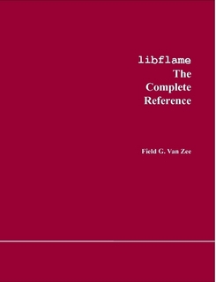
libflame
Reimplementation of important parts of LAPACK
Families of algorithms for key operations
Improvements to important algorithms
Reduction to condensed form
Symmetric QR algorithm for computing the Spectral Decomposition and SVD
Alternative (object based) interface
Comprehensive users’ guide

Slide 102
Related Publications
Field G. Van Zee. libflame: The Complete Reference. www.lulu.com, 2009
Field G. Van Zee, Ernie Chan, Robert A. van de Geijn, Enrique S. Quintana-Orti, Gregorio Quintana-Orti. The libflame Library for Dense Matrix Computations. IEEE CiSE, Vol. 11, No 6, 2009
Field G. Van Zee, Robert A. van de Geijn, Gregorio Quintana-Ortí, G. Joseph Elizondo. Families of Algorithms for Reducing a Matrix to Condensed Form. ACM Transactions on Mathematical Software (TOMS), 2012
Field G. Van Zee, Robert A. van de Geijn, Gregorio Quintana-Ortí. Restructuring the Tridiagonal and Bidiagonal QR Algorithms for Performance. ACM Transactions on Mathematical Software (TOMS), 2014

Slide 103
Speak the Language
FLAME
Notation
Methodology
APIs
FLAMEC
FLAME@lab
FLAMEPy
FLaTeX
libflame
SuperMatrix
FLAPACK
Elemental
BLIS
LAC/LAP
DxT
LAFF

Slide 104
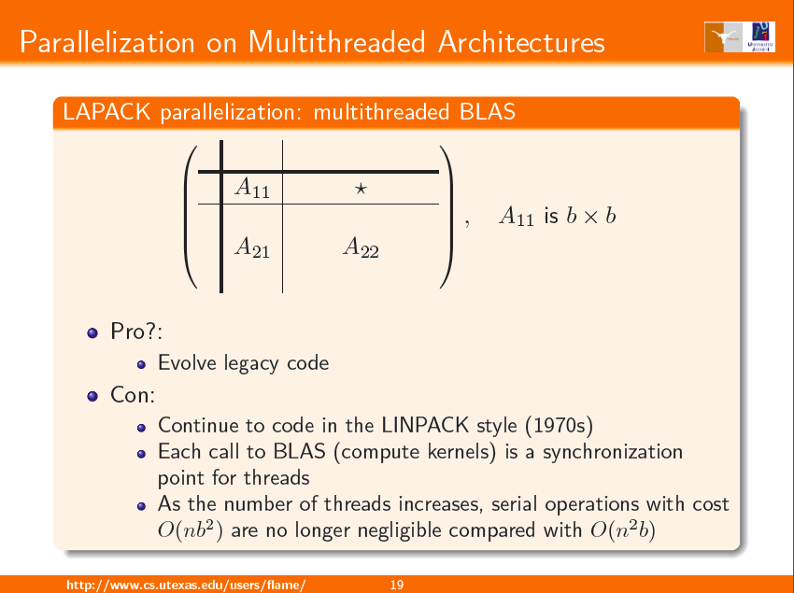

Slide 105
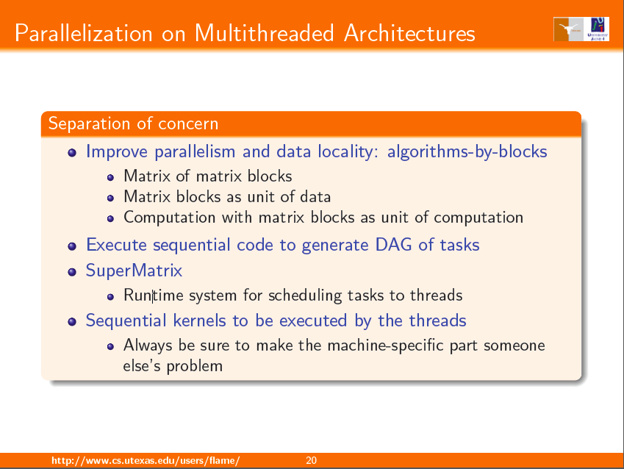

Slide 106
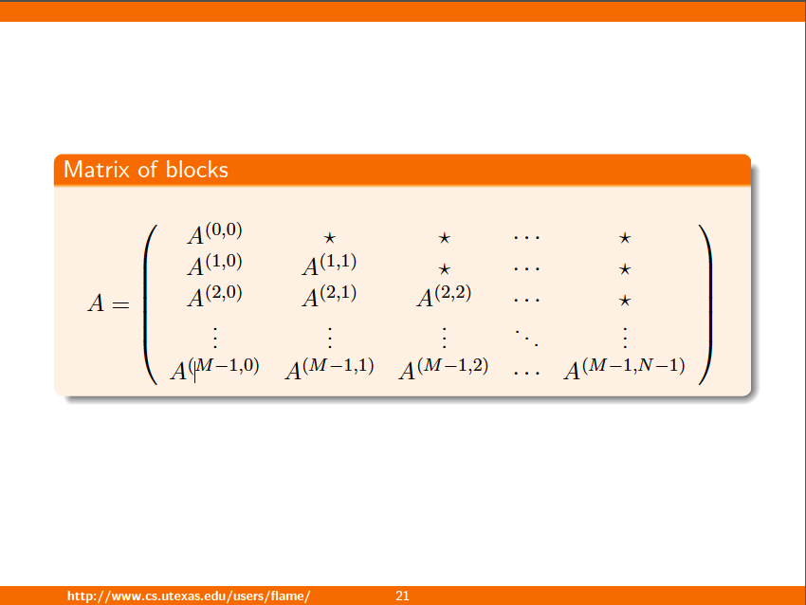

Slide 107
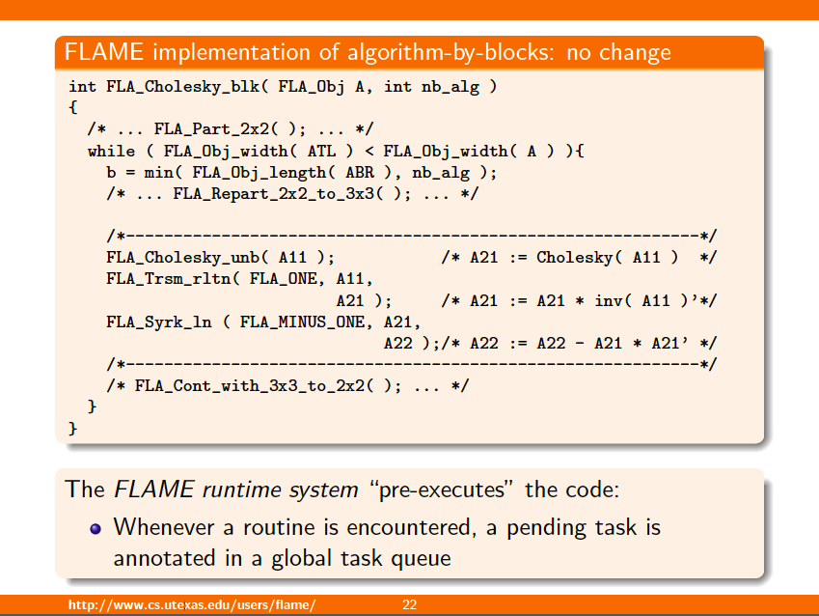

Slide 108
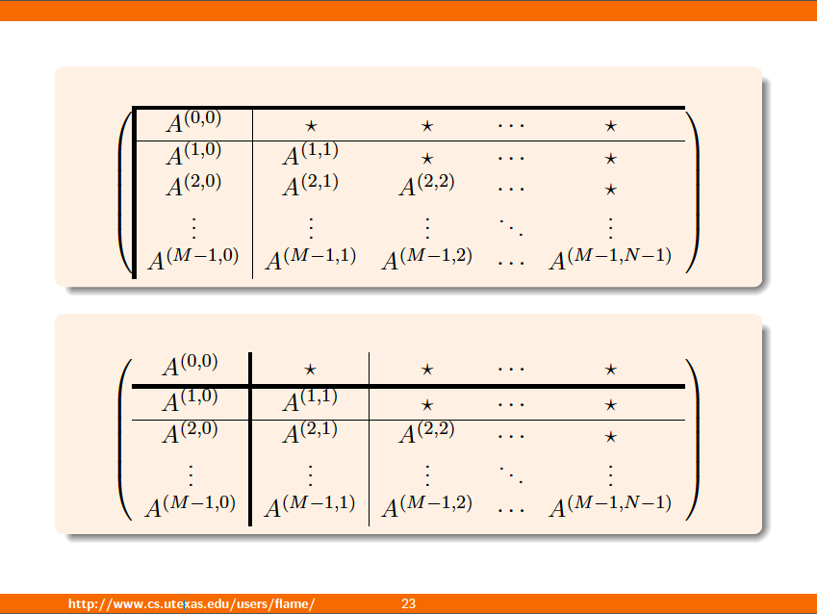

Slide 109
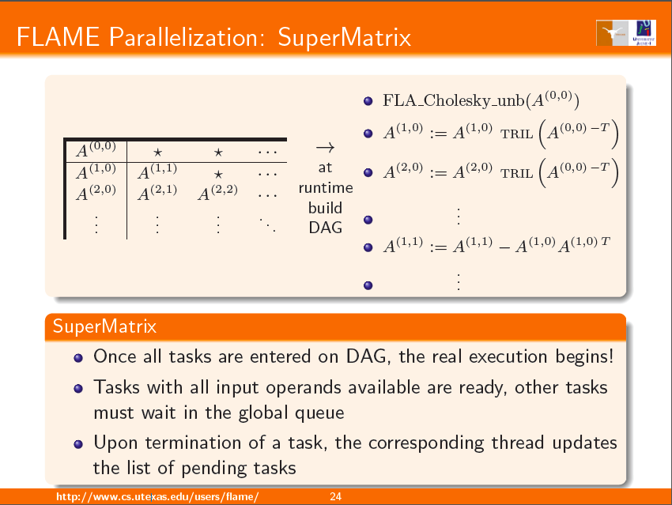

Slide 110
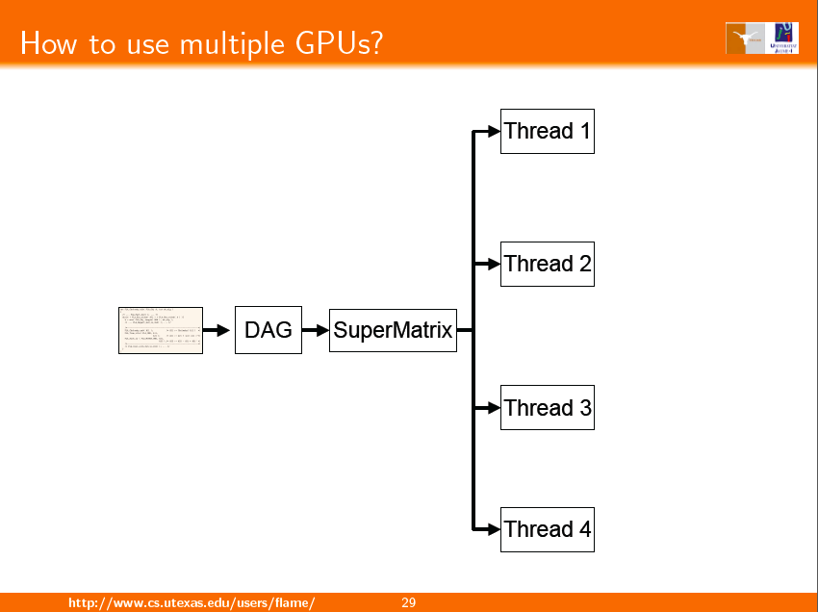

Slide 111
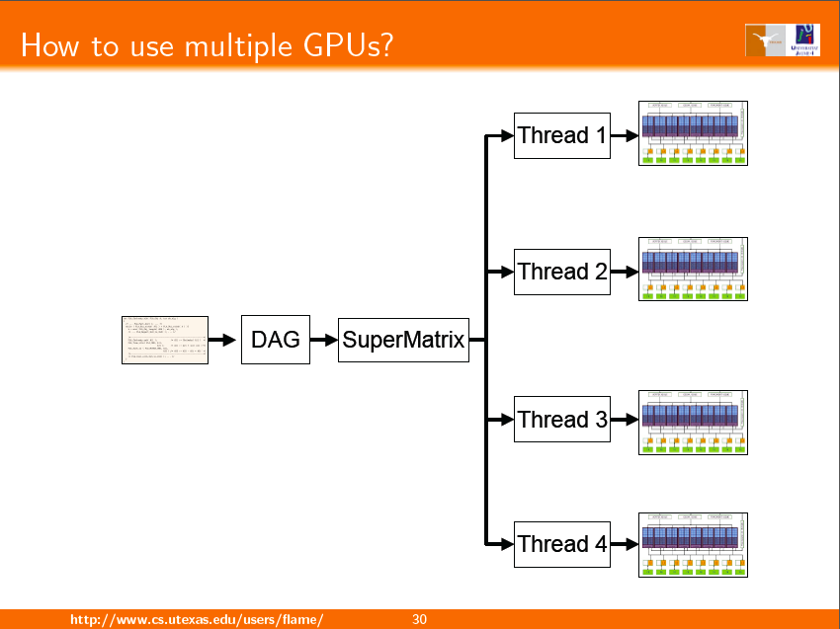

Slide 112
Related Publications
Tze Meng Low and Robert van de Geijn. An API for Manipulating Matrices Stored by Blocks. FLAME Working Note #12. 2004
F. D. Igual, E. Chan, E. S. Quintana-Ortí, G. Quintana-Ortí, R. A. van de Geijn, and F. G. Van Zee. The FLAME approach: From dense linear algebra algorithms to high-performance multi-accelerator implementations. JPDC. 2012.
F. G. Van Zee, E. Chan, E. S. Quintana-Ortí, G. Quintana-Ortí, and R. A. van de Geijn. Introducing: The libflame library for dense matrix computations. IEEE CiSE, 2009.
E. S. Quintana-Ortí, G. Quintana-Ortí, R. A. van de Geijn, F. G. Van Zee, and E. Chan. Programming matrix algorithms-by-blocks for thread-level parallelism. ACM Transactions on Mathematical Software, 36(3):14:1-14:26, July 2009.
E. Chan, A. Chapman, and R. van de Geijn. Managing the complexity of lookahead for LU factorization with pivoting. SPAA'10. 2010.Greece, June 13-15, 2010.
E. S. Quintana-Ortí, G. Quintana-Ortí, E. Chan, R. van de Geijn, and F. G. Van Zee. Design of scalable dense linear algebra libraries for multithreaded architectures: the LU factorization. In MTAAP'08. 2008.
E. Chan, F. G. Van Zee, P. Bientinesi, E. S. Quintana-Ortí, G. Quintana-Ortí, and R. van de Geijn. SuperMatrix: A multithreaded runtime scheduling system for algorithms-by-blocks. PPoPP'08. 2008.
E. S. Quintana-Ortí, G. Quintana-Ortí, E. Chan, R. A. van de Geijn, and F. G. Van Zee. Scheduling of QR factorization algorithms on SMP and multi-core architectures. PDP'08. 2008.
E. Chan, F. G. Van Zee, E. S. Quintana-Ortí, G. Quintana-Ortí, and R. van de Geijn. Satisfying your dependencies with SuperMatrix. Cluster'07. 2007.
E. Chan, E. S. Quintana-Ortí, G. Quintana-Ortí, and R. van de Geijn. SuperMatrix out-of-order scheduling of matrix operations for SMP and multi-core architectures. SPAA'07. 2007.
Gregorio Quintana-Orti, Francisco D. Igual, Enrique S. Quintana-Orti, Robert A. van de Geijn. Solving dense linear systems on platforms with multiple hardware accelerators. PPoPP ’00, 2009.

Slide 113
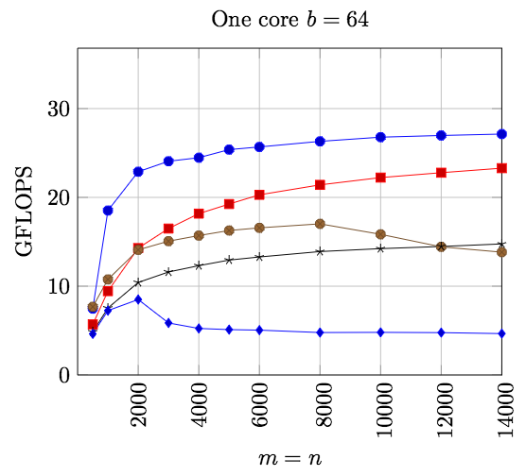
Rank-revealing QR Factorization
Blocked QR factorization
QR factorization
with Randomized
Pivoting
Rank-revealing QR factorization
LAPACK
Per-Gunnar Martinsson, Gregorio Quintana-Orti, Nathan Heavner, Robert van de Geijn. Householder QR Factorization: Adding Randomization for Column Pivoting. FLAME Working Note #78. 2015.

Slide 114
Summary
Intelligent design for rewriting the DLA software stack from scratch.
Rapid development, minimal testing, high performance, maintainable.

Slide 115
Overview
Notation
Methodology
APIs
libflame
Full LAPACK functionality
Elemental
BLIS
DxT/DxTer
Lessons/Conclusion

Slide 116

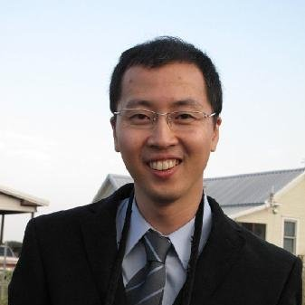
Full LAPACK Functionality/Compatibility
libflame provides
Subset of LAPACK functionality
Alternative (object-based) interface
Desirable:
Full LAPACK functionality
Backward compatibility
LAPACK has millions of lines of code…
Dr. Kyungjoo Kim
to the rescue

Slide 117
Full LAPACK Functionality/Compatibility
LAPACK -> f2c -> fix a bit -> FORTRAN FREE LIBRARY
For each LAPACK routine
If libflame has functionality
Use LAPACK routine as interface
Rip out guts
Call libflame routine
Result: “FLAPACK”
No Fortran
Full LAPACK functionality
Passes LAPACK test suite
Part of standard libflame release
Gives a path for incrementally replacing all of LAPACK

Slide 118
Summary
Have no shame: Incorporate legacy code when convenient.
Tremendous value in LAPACK test suite
FLAME derivation yields correctness in the absence of round off error.
Numerical stability very important.

Slide 119
Overview
Notation
Methodology
APIs
libflame
Full LAPACK functionality
Elemental
BLIS
DxT/DxTer
Lessons/Conclusion

Slide 120
Elemental
Developed by Jack Poulson
Distributed memory DLA library (but now so much more…)
Has gained wide use at the national labs
Coding style and theoretical underpinnings inspired by PLAPACK and FLAME
Elemental is now a lot more than just a DLA library

Slide 121
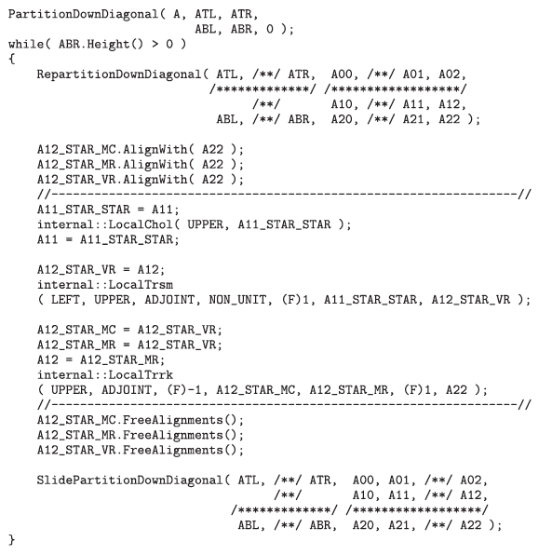

Slide 122
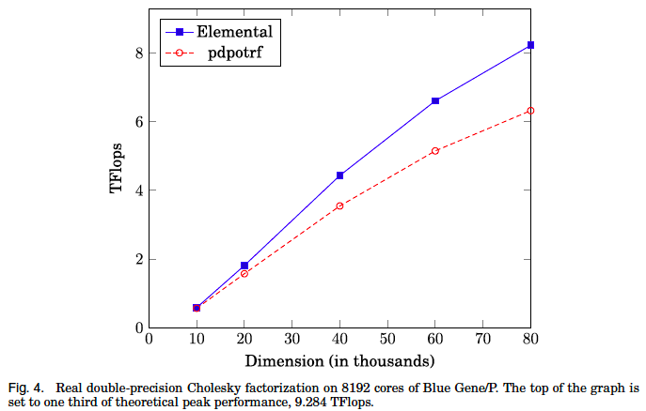
Much of the improvement in performance comes from
using MPI collectives
Elemental: A New Framework for Distributed Memory Dense Matrix Computations
Jack Poulson, Bryan Marker, Robert A. van de Geijn, Jeff R. Hammond, Nichols A. Romero
ACM Transactions on Mathematical Software (TOMS), 2013

Slide 123
Related Publications
Martin D. Schatz, Robert A. van de Geijn, Jack Poulson. Parallel Matrix Multiplication: A Systematic Journey. SISC. To appear (pending minor modifications)
Jack Poulson, Bryan Marker, Robert A. van de Geijn, Jeff R. Hammond, Nichols A. Romero. Elemental: A New Framework for Distributed Memory Dense Matrix Computations. TOMS, 2013

Slide 124
Summary
With Elemental we come full circle
PLAPACK now obsolete

Slide 125
Overview
Notation
Methodology
APIs
libflame
Full LAPACK functionality
Elemental
BLIS
DxT/DxTer
Lessons/Conclusion

Slide 126
BLAS-Like Library Instantiation Framework
Framework for rapid instantiation of the BLAS
Level 1, 2, and 3 BLAS
Alternative APIs
Set of building blocks for BLAS-like operations

Slide 127
n_{C}
5th loop around micro-kernel
n_{C}
C_{j}
+=
A
B_{j}
4th loop around micro-kernel
k_{C}
B_{p}
C_{j}
+=
A_{p}
k_{C}
~
Pack B_{p} → B_{p}
3rd loop around micro-kernel
C_{i}
m_{C}
m_{C}
A_{i}
~
B_{p}
+=
~
Pack A_{i} → A_{i}
n_{R}
2nd loop around micro-kernel
~
n_{R}
~
C_{i}
A_{i}
B_{p}
m_{R}
+=
k_{C}
1st loop around micro-kernel
n_{R}
m_{R}
+=
k_{C}
micro-kernel
main memory
1
L3 cache
+=
L2 cache
1
L1 cache
registers

Slide 128
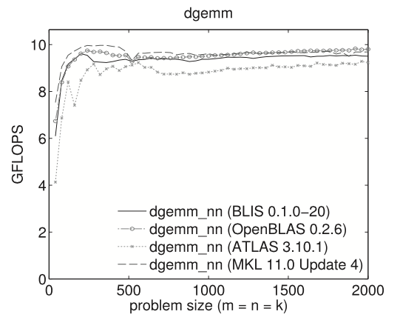
Intel Xeon “Dunnington” (one core)

Slide 129
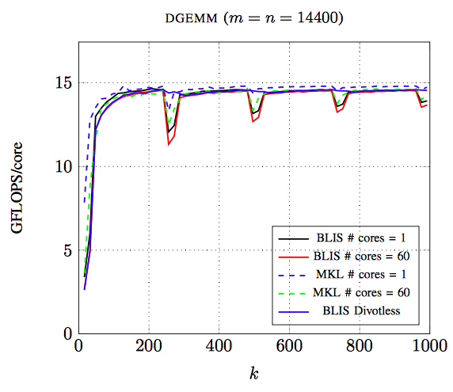
Intel Xeon Phi
240 threads
84% of peak
Tyler M. Smith, Robert van de Geijn, Mikhail Smelyanskiy, Jeff R. Hammond, and Field G. Van Zee. Anatomy of High-Performance Many-Threaded Matrix Multiplication. IPDPS 2014.

Slide 130
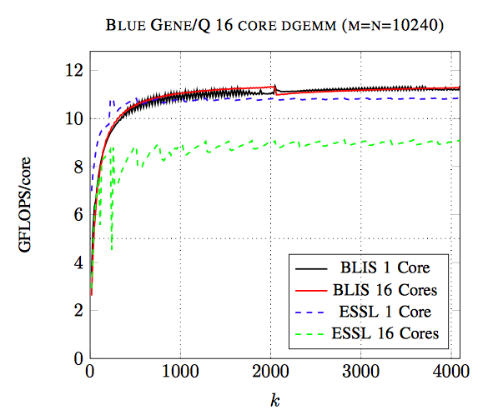
Intel Xeon Phi
Tyler M. Smith, Robert van de Geijn, Mikhail Smelyanskiy, Jeff R. Hammond, and Field G. Van Zee. Anatomy of High-Performance Many-Threaded Matrix Multiplication. IPDPS 2014.

Slide 131
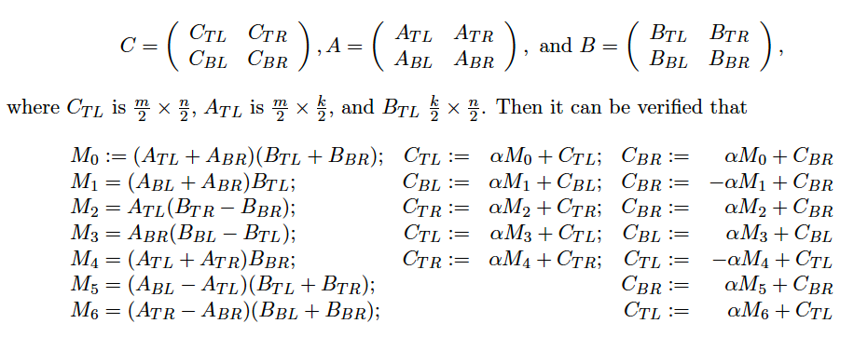
Playing Legos with BLIS
Strassen

Slide 132
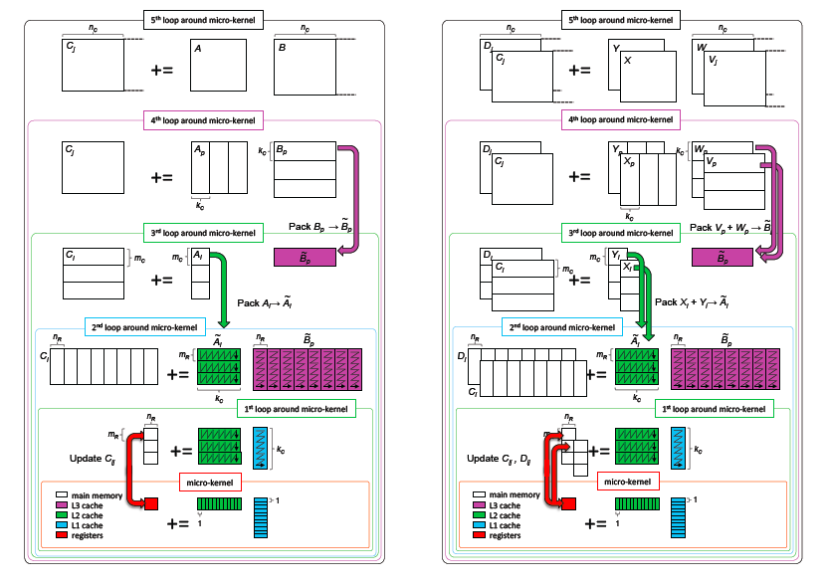

Slide 133
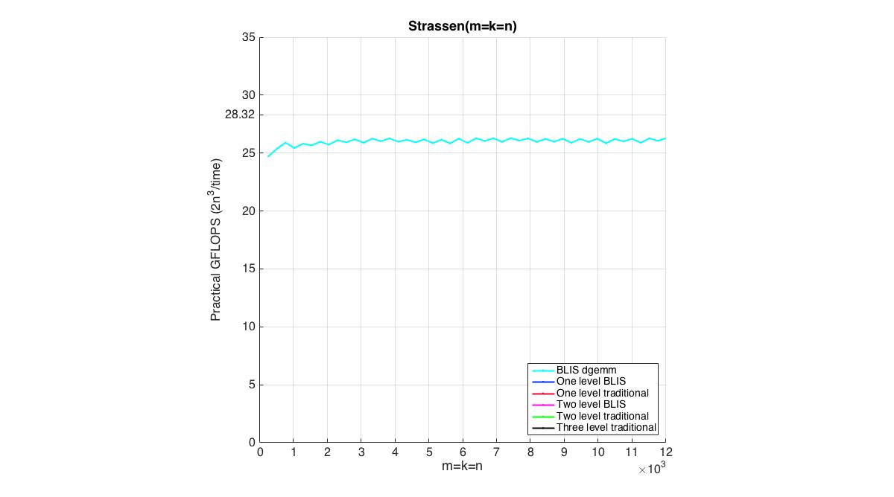

Slide 134
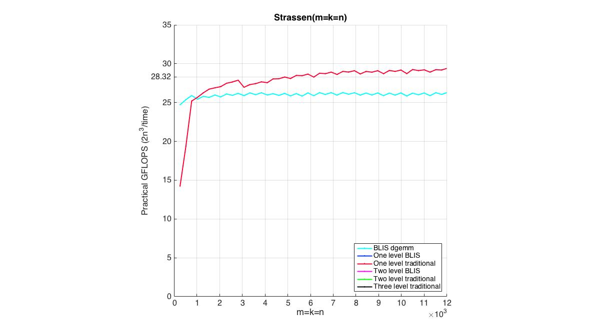

Slide 135
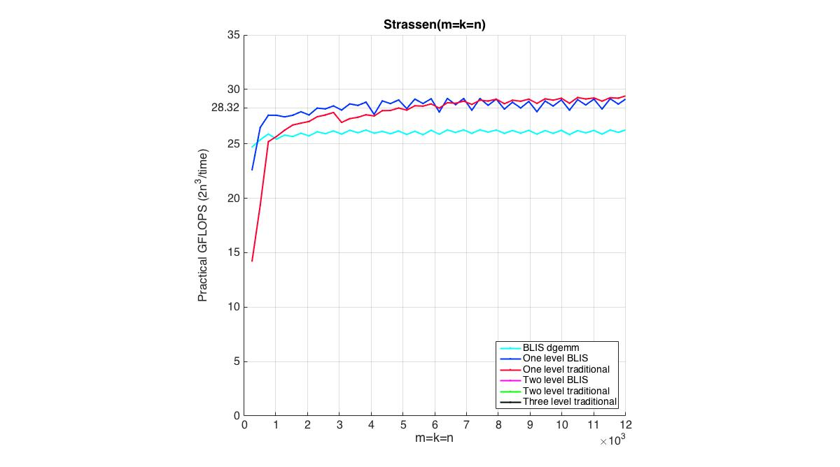

Slide 136
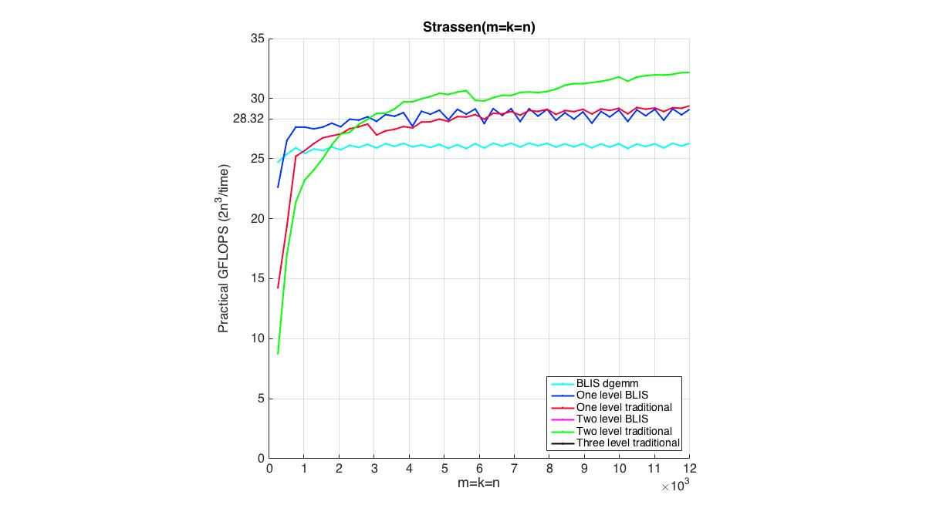

Slide 137
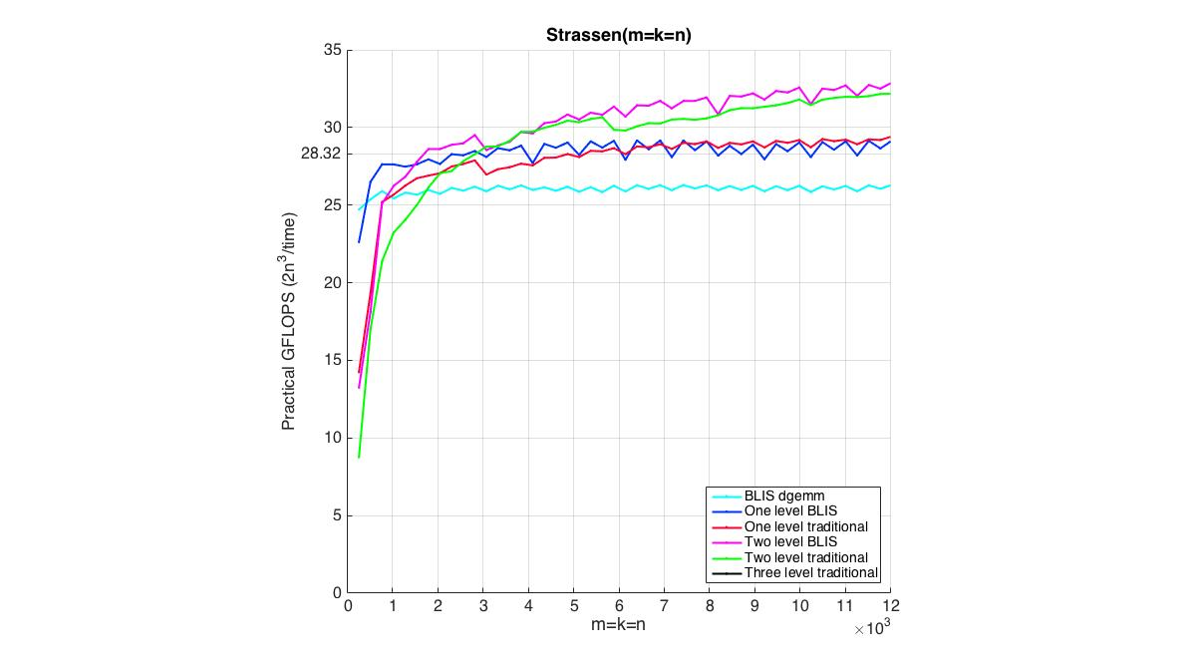

Slide 138
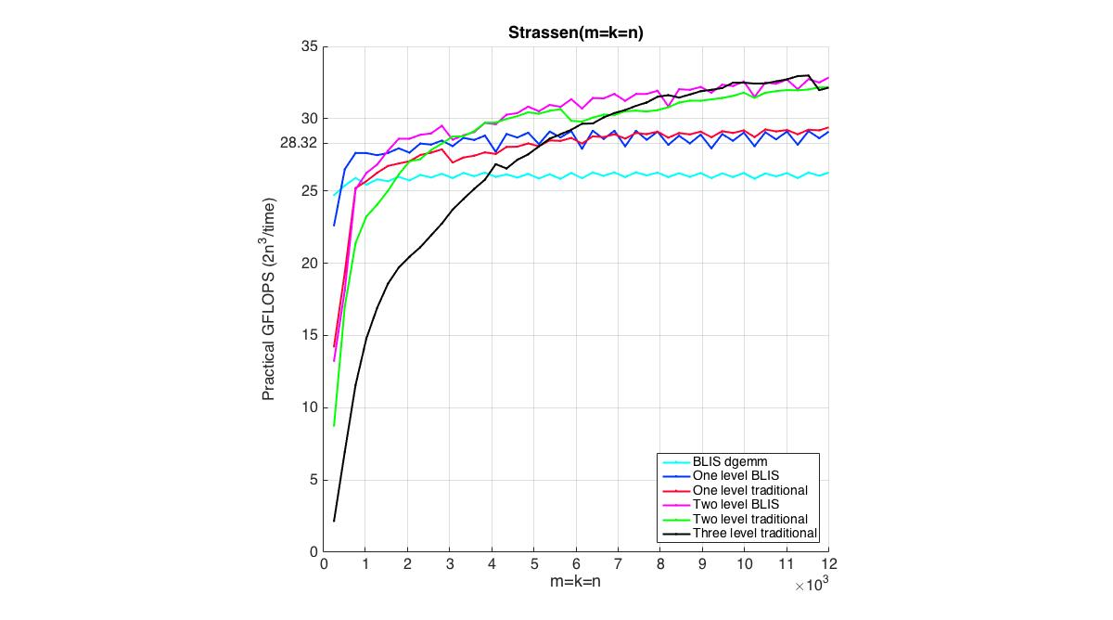

Slide 139
Related Publications
John A. Gunnels, Greg M. Henry, and Robert A. van de Geijn. A Family of High-Performance Matrix Algorithms. In Computational Science - 2001.
Kazushige Goto, Robert A. van de Geijn. Anatomy of high-performance matrix multiplication. ACM Transactions on Mathematical Software (TOMS), 2008.
Kazushige Goto, Robert van de Geijn. High-performance implementation of the level-3 BLAS. ACM Transactions on Mathematical Software (TOMS), 2008
Field G. Van Zee, Robert A. van de Geijn. BLIS: A Framework for Rapidly Instantiating BLAS Functionality. ACM Transactions on Mathematical Software (TOMS), 2015
Tyler M. Smith, Robert van de Geijn, Mikhail Smelyanskiy, Jeff R. Hammond, and Field G. Van Zee. Anatomy of High-Performance Many-Threaded Matrix Multiplication. IPDPS 2014.
Field G. Van Zee, Tyler Smith, Bryan Marker, Tze Meng Low, Robert A. van de Geijn, Francisco D. Igual, Mikhail Smelyanskiy, Xianyi Zhang, Michael Kistler, Vernon Austel, John Gunnels, Lee Killough. The BLIS Framework: Experiments in Portability. ACM Transactions on Mathematical Software. To appear.

Slide 140
Summary
Careful refactoring of GotoBLAS
Less code to optimize
More loops to parallelize
Microkernel supports all level-3 BLAS
Similar kernels for level-2 BLAS
Provides building blocks for innovative optimization
Distributed by AMD, ARM, Texas Instruments, and Movidius

Slide 141
Overview
Notation
Methodology
APIs
libflame
Full LAPACK functionality
Elemental
BLIS
DxT/DxTer
Lessons/Conclusion

Slide 142
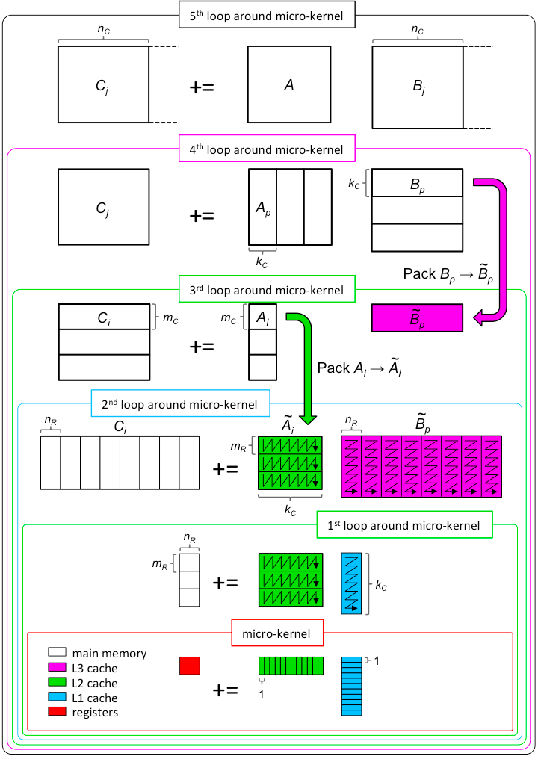

Slide 143
Design-by-Transformation (DxT)
Currently: Libraries exist as code
Future:
Notation/Domain Specific Language
Encode knowledge about algorithms and architectures
Tools search algorithmic design space and produce an optimal implementation
Examples
DxTer
Tensor Contraction Engine
Spiral

Slide 144
Related Publications
Bryan Marker, Martin Schatz, Devin Matthews, Isil Dillig, Robert van de Geijn, and Don Batory. DxTer: An Extensible Tool for Optimal Dataflow Program Generation. Tech Report.
Bryan Marker, Don Batory, and Robert van de Geijn. “Understanding Performance Stairs: Elucidating Heuristics.” International Conference on Automated Software Engineering 2014.
Bryan Marker, Don Batory, and Robert van de Geijn. “Code Generation and Optimization of Distributed-Memory Dense Linear Algebra Kernels.” iWAPT 2013.
Bryan Marker, Jack Poulson, Don Batory, and Robert van de Geijn. “Designed Linear Algebra Algorithms by Transformation: Mechanizing the Expert Developer.” iWAPT 2012.

Slide 145
Summary
An expert optimizes at all levels
Automate rote tasks
The future of libraries:
Not instantiated in code
Encode algorithms, expert knowledge, and knowledge about target architectures
Mechanically explore the software design space

Slide 146
Overview
Notation
Methodology
APIs
libflame
Full LAPACK functionality
Elemental
BLIS
DxT/DxTer
Lessons/Conclusion

Slide 147
Conclusion
It starts with notation
Formal derivation (goal-oriented programming) is practical for loop-based algorithms
Code should closely reflect algorithms
Portable

Slide 148









Sponsors

Slide 149
Software Infrastructure for Sustained Innovation
Award ACI-1148125:
Collaborative Research: SI2-SSI: A Linear Algebra Software Infrastructure for Sustained Innovation in Computational Chemistry and other Sciences.
Robert van de Geijn, Don Batory, Victor Eijkhout, Maggie Myers, John Stanton, Jeff Hammond
Any opinions, findings, and conclusions or recommendations expressed in this material are those of the author(s) and do not necessarily reflect the views of the National Science Foundation.

Slide 150
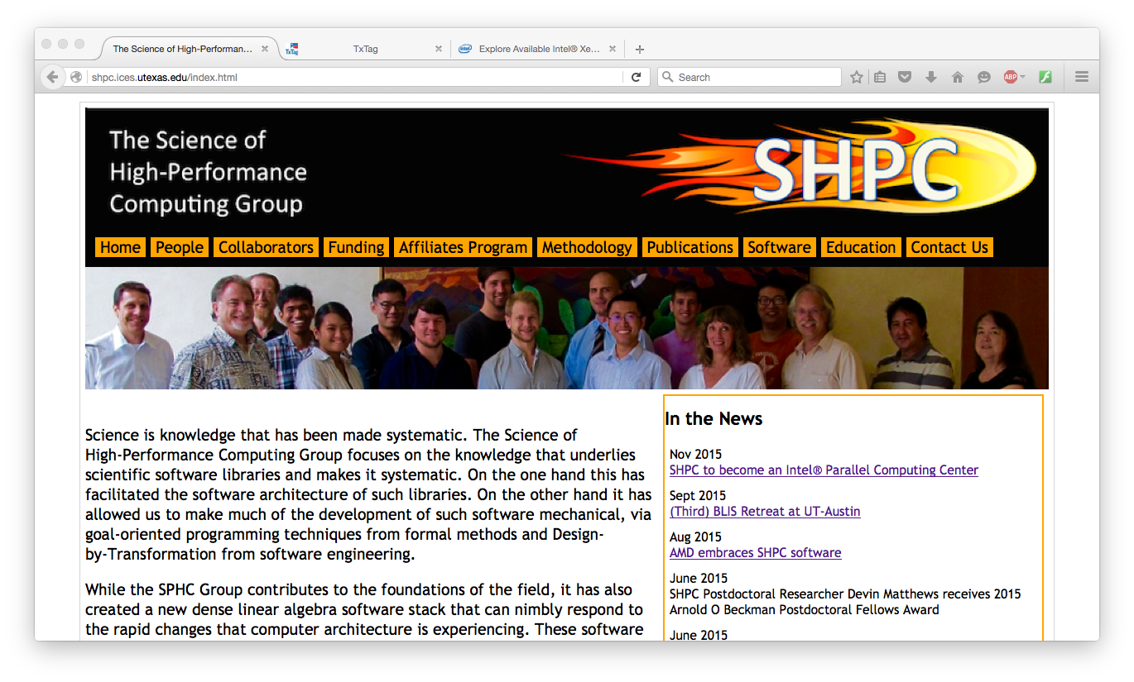
The Team

